Slide 1
What is MongoDB?

Slide 2
What is MongoDB?
MongoDB is a Document Database
Instead of Tables (rows and columns) data is stored in documents in the JSON format
JSON stands for JavaScript Object Notation
Instead of SQL, MongoDB using MongoDB Query Language (MQL)
MQL is based on JavaScript syntax

Slide 3
Tables vs Documents
{_id:1, Name:”Guy”, Address: “Melbourne”, email: “guy@guy.com”
Customers Table
ID | Name | Address | email
1 | Guy | Melbourne | guy@guy.com
orders:[ {orderId:1, date:”Feb 2020”,
lineItems: [{lineItemId:1,
Item:”Chocolate”},
{lineItemId:2,
Item:”More Chocolate”}],
{orderId: 2, date “Jan 2022”}] }
orders:[ {orderId:1, date:”Feb 2020”},
{orderId: 2, date “Jan 2022”}]
Orders Table
ID | CustId | Date
1 | 1 | Feb 2020
2 | 1 | Jan 2022
LineItem Table
Order ID | LineItemId | Item
1 | 1 | Chocolate
1 | 2 | More Chocolate

Slide 4
Documents: Advantages and Disadvantages
Advantages
Fast lookups
Easy for programmers
Disadvantages
Redundancy
Slower updates
Rapid development
Difficult analytics
No Joins
More object-oriented
No ALTER TABLE
Can cause inconsistencies
(sometimes)
No SQL

Slide 5
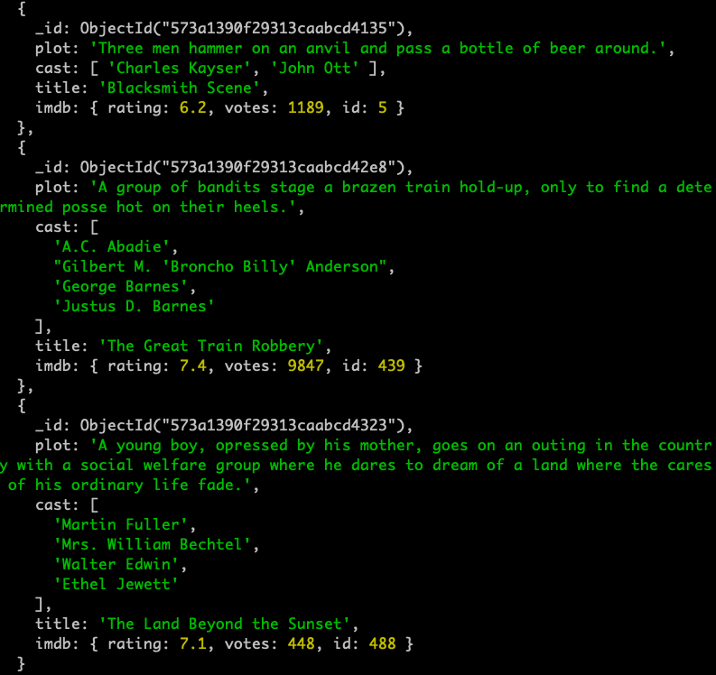
JSON in MongoDB
MongoDB using a special variation of JSON called BSON. BSON is fast an efficient, but mostly we’ll use JSON and BSON interchangeably.
A collection is a group of related JSON documents. A collection is similar to a table in SQL databases
JSON consists of:
Attributes: Name value pairs
Objects: groups of attributes
Arrays: repeating groups of objects
Document
Collection
Attribute
Object
Array

Slide 6
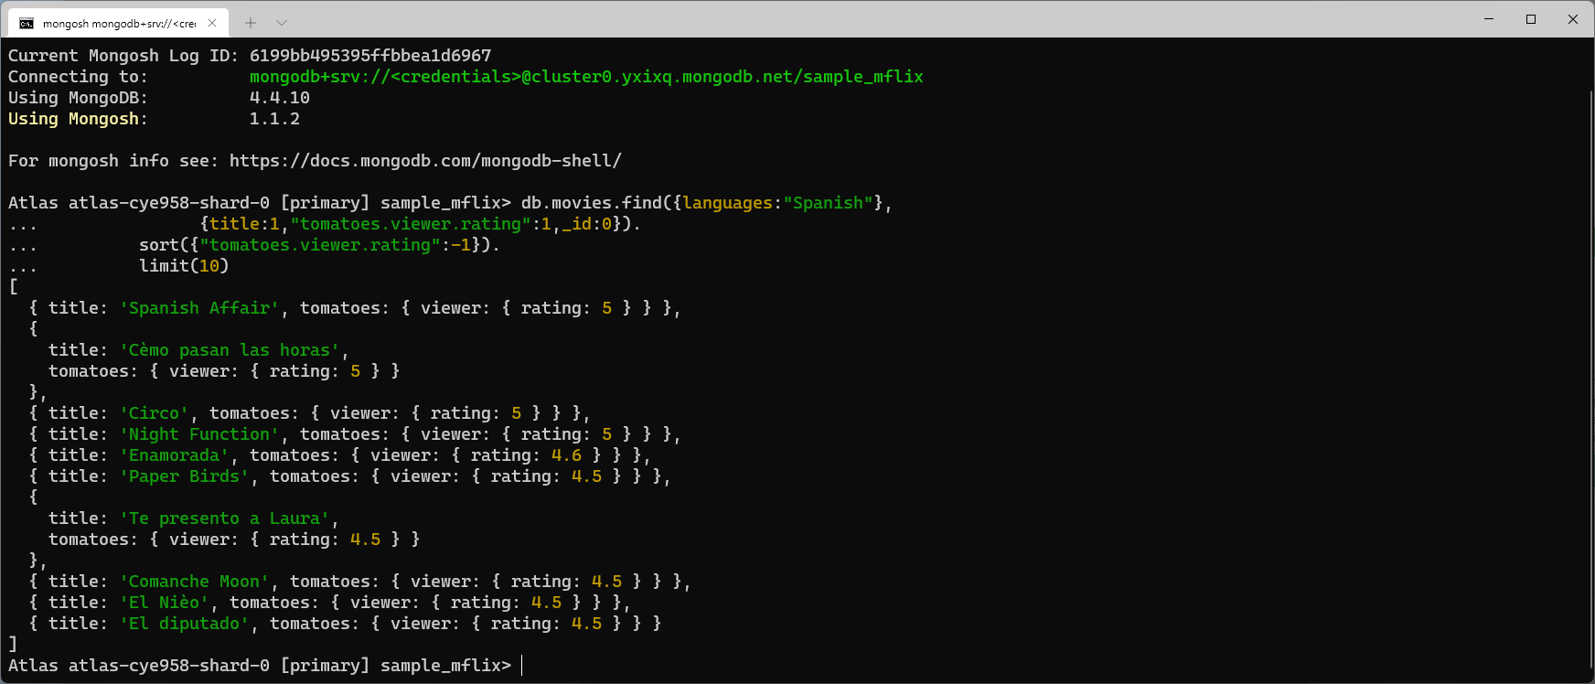
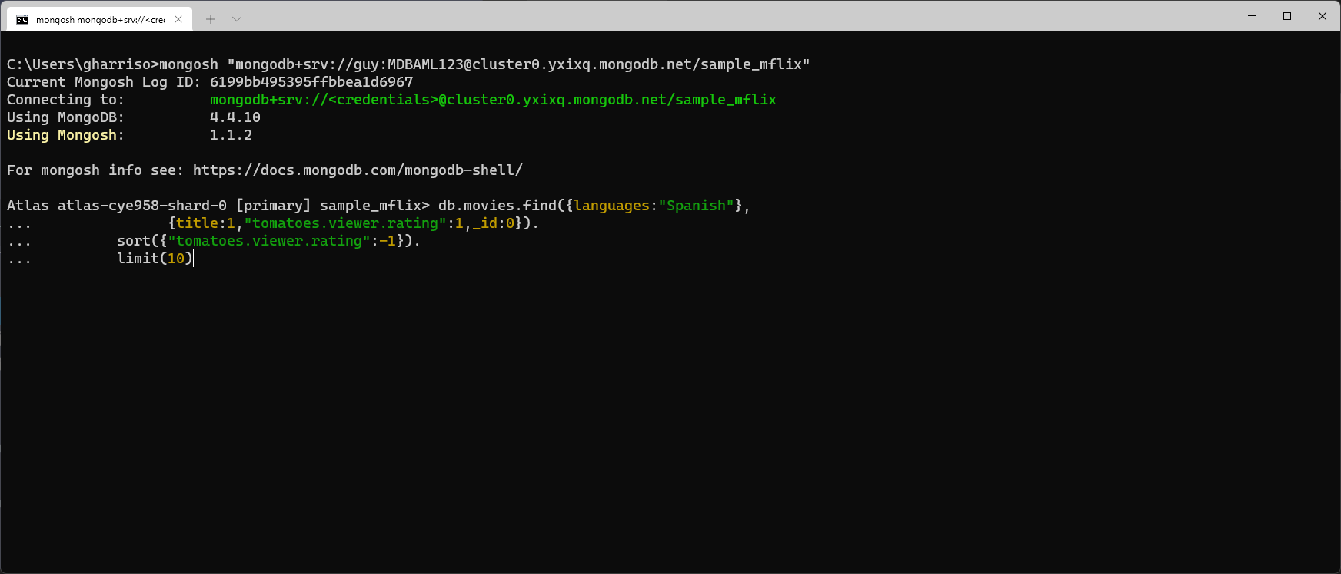
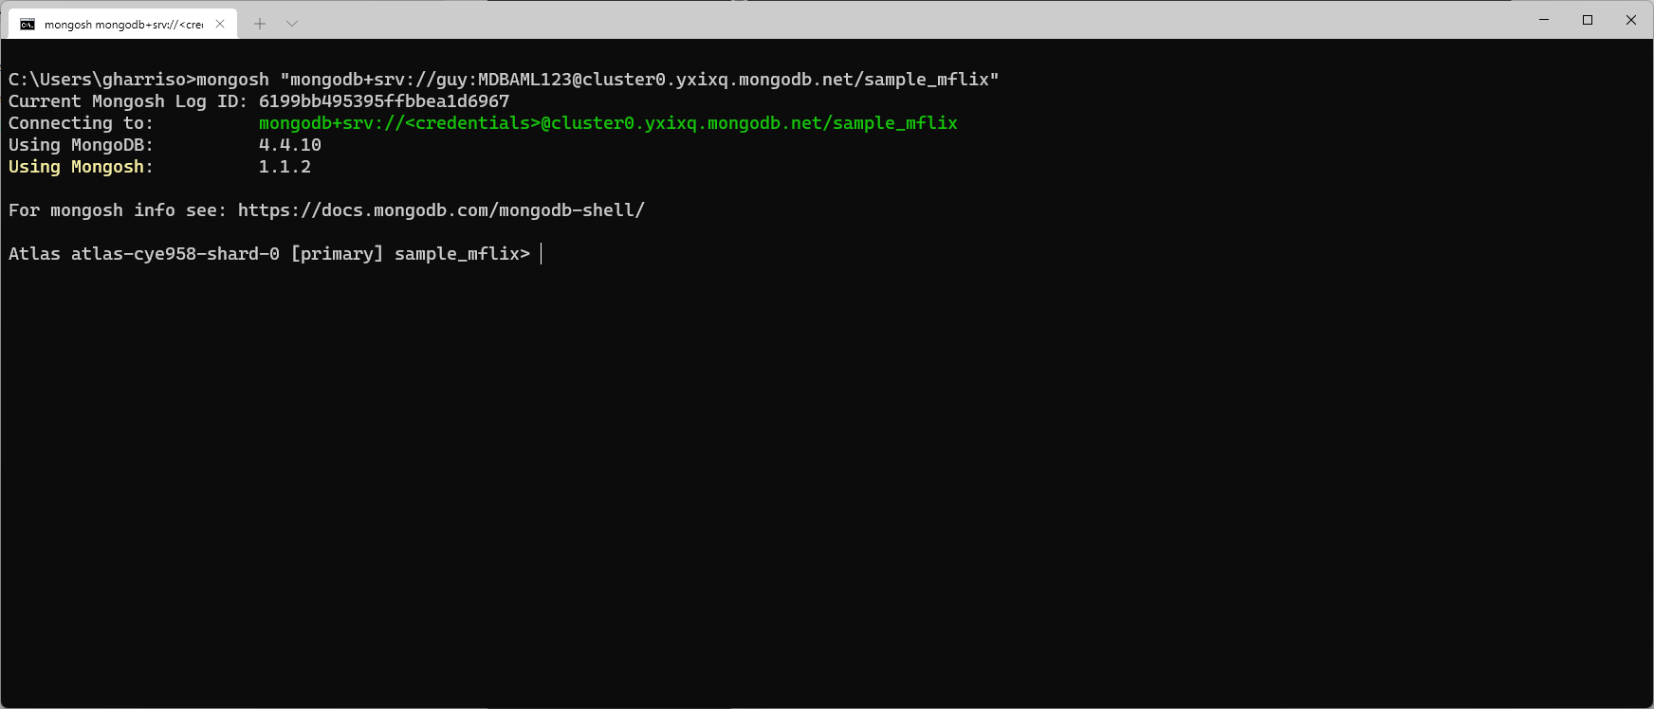
MongoDB Query Language
Query filter
Attributes to be returned
Sort Results
Documents to be returned

